Slide 1
Adolescent Health 2020
Name:
School:
Professor:
Date:

Slide 2
Understanding Adolescent Health
The leading causes of illness and death among the youth is preventable. The prevention is linked to different social factors such s the;
1. Family
Adolescent need good communication to care about their health
Parents ought to promote a safe environment to explore health opportunities
2. The school
- Student health on risky behavious

Slide 3
Major Health Concerns
-Adolescent Health concerns key facts
It is estimated that 1.2 million adolescents died in 2015. i.e. approximately over 3000 adolescents died daily
-Major health risks include respiratory infection and diarrhea diseases
-Mental health disorders in adolescents is a major concern.
Most of the adolescent health's are premature illness, death. Other causes of health concerns include alcohol and drugs, malnutrition and obesity among others

Slide 4
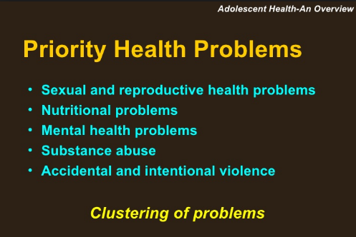
Major Health Concerns

Slide 5
2. Healthy people goals and objectives
- Increase wellness checkup in every year
-To promote the participation of youths in work out activities/physical exercises
- Protect the adolescents e.g. youths from drug use
- Reduce the proportion of violence in schools e.g. gun violence which could lead to death or injury
- To maintain healthy eating habits.

Slide 6
3. Overview of national and community implementation efforts
1. Community mobilization to support access for medical care
2. Stakeholder education to reach adolescent groups in the community geared towards health
3. Increase access to contraceptive and reproductive health
4. Evidence-based programs that will give youths health lessons
5. Provision of health services for youth in medical facilities e.g. health workshops, awareness on sex education e.g. contraceptive cancelling

Slide 7
4. National Data Trending on Adolescent Health
- The diversity in cultural responsiveness has sharpened the attention of adolescents on health matters
- The mental health has profound impact on health well being of the youths. Mental health for 50% of the adolescents begins at the age of 14 and 75% of the population begins at the age of 24
- Positive youth development (PYD) intervention are needed in the nation to address health risk behaviors.

Slide 8
5. Health efforts at community Level for the adolescents
- Emphasize on social insurance administrations to give brilliant screening, appraisal, wellbeing administration, referral, and to youth.
- Arrange behavioral, regenerative, psychological well-being, and dental administrations practically speaking and group settings.
- Incorporate wellbeing advancement, sickness counteractive action, and youth improvement all through the wellbeing framework and inside the group.
Concentrate on the wellbeing and wellbeing administration needs of those young people who are most helpless against unsafe conduct and weakness.
Guarantee assent and classification for young people looking for healthcare.

Slide 9
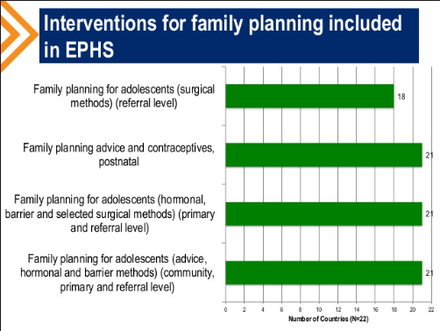
Scenario of a family planning for adolescents in the community

Slide 10
Conclusion
Findings from youth focus groups and evidence-based program pre-surveys/post surveys showed a strong need among adolescents to have information on how and where to access Health Services. Delivery of the supplemental lesson on how and where to make an appointment, which led to knowledge gains on access to Health services, highlights the importance of providing teens with this information. The Office of Adolescent Health Teen Pregnancy Prevention Program's investment in increasing the reach of evidence-based teen pregnancy prevention interventions across the country provides an opportunity for the field to consider the utility of adding a supplemental lesson on access to Health services.

Slide 11
Reference
Blum, R. W., & Alton, I. R. (2012). Adolescent health care: Clinical issues. New York: Academic Press.
DiClemente, R. J., Hansen, W. B., & Ponton, L. E. (2016). Handbook of adolescent health risk behavior. New York: Plenum.
Wallander, J. L., & Siegel, L. J. (2015). Adolescent health problems: Behavioral perspectives. New York: The Guilford Press.

